Slide 1
Lab 9: Practice ID
Cerebral Fiber Pathways-Fiber Dissection
Ryan Dickerson, BSOM 2025
Mack Morgan, BSOM 2026

Slide 2
Mission Statement
SCRUBS is a student-driven initiative that aims to develop supplemental resources for current and future cohorts that will pass through Brody. Members of SCRUBS participate in a variety of sub-committees working to create resources for students, by students. These resources aim to offer unique perspectives from students that have walked in the same shoes, developing resources that we wish we had been exposed to during our time in the course.
The hope is this organization will become a staple of the Brody student body, exemplifying the unique collaborative community that Brody offers. If this is a mission that aligns with your goals and you have the desire to help those that will come behind you, as well as a goal to leave your mark on Brody as a whole, we invite you to join the team!

Slide 3
Disclaimer
The resources that are included in this document are made by students and not the faculty. As such, there is the possibility for errors in our development, although this is mitigated via a team approach to development with multiple stages of vetting. If there is a contradiction with the coursework presented within your course, please go by the course documents. Additionally, SCRUBS aims to supply supplemental resources, however these are in no way replacements to the instruction of the Brody faculty. Use these resources as a supplement, but not as your primary source for course material.

Slide 4
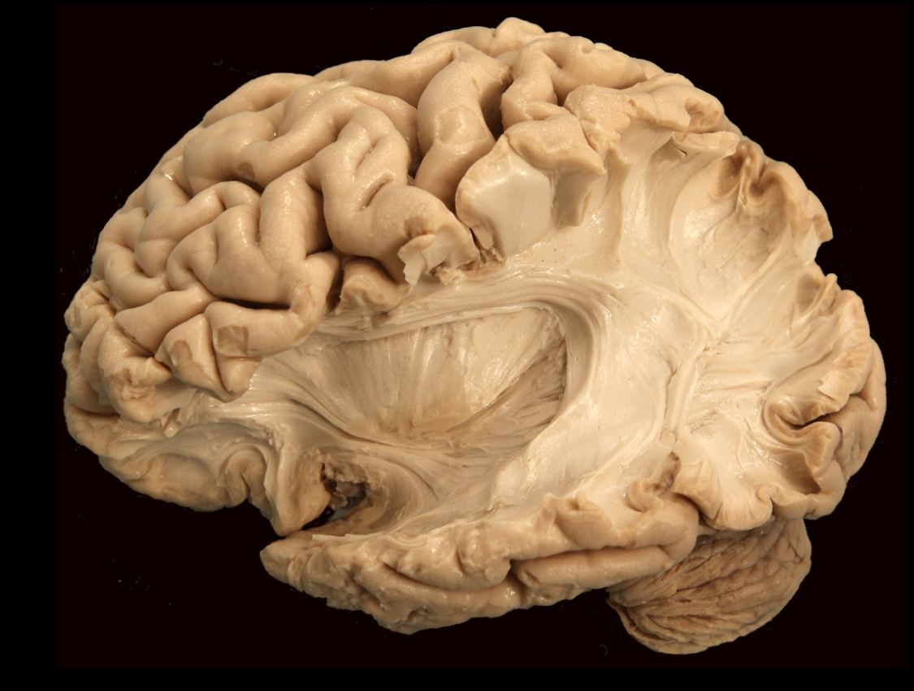
Notes:
Arcuate fiber (short association fiber): Travels to adjacent gyri (mostly from cortical layer 3: external pyramidal)

Slide 5
Notes:
Superior longitudinal fasciculus: Association fiber tract superior to the insula, connects Broca’s and Wernike’s. Also called the arcuate fasciculus (though arcuate fasciculus is usually the posterior diving part)

Slide 6
Notes:
Arcuate Fasciculus: Association fiber tract curving above the insula. Another name for the superior longitudinal fasciculus (though typically the posterior, diving portion of the SLF).

Slide 7
Notes:
Uncinate fasciculus: Associational tract, temporal lobe subcomponent of the inferior occipitofrontal fasciculus. Interconnects the orbital gyri with anterior temporal cortical regions.

Slide 8
Notes:
Inferior occipitofrontal fasciculus: Association fiber tract inferior to the insula that connects frontal, temporal, and occipital lobes.

Slide 9
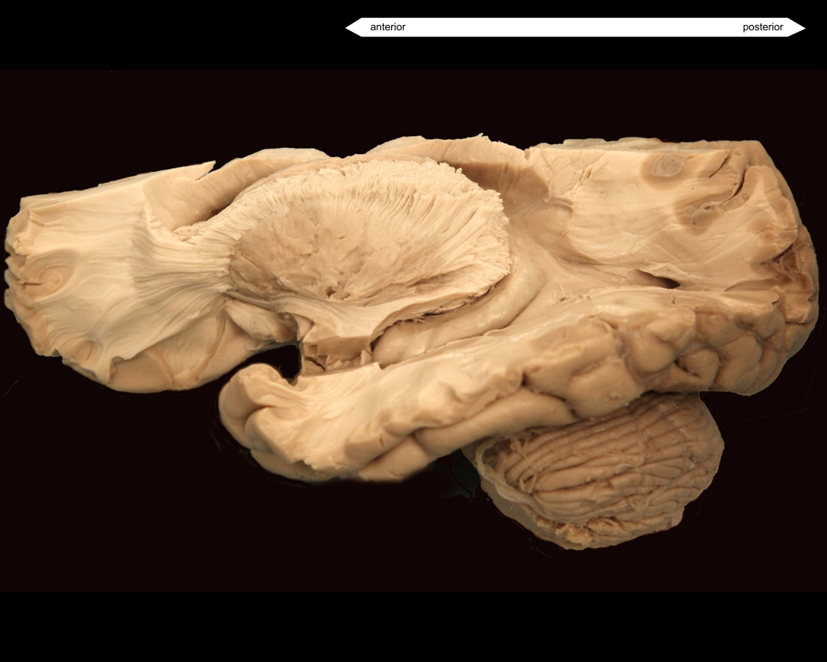
Notes:
Arcuate fiber (short association fiber): Travels to adjacent gyri (mostly from cortical layer 3: external pyramidal)

Slide 10
Notes:
External capsule: Separates the putamen and claustrum.

Slide 11
Notes:
Inferior occipitofrontal fasciculus: Association fiber tract inferior to the insula that connects frontal, temporal, and occipital lobes.

Slide 12
Notes:
Optic radiations (geniculocalcarine tract): Secondary visual sensory fibers coming from the lateral geniculate nucleus and running to the primary visual cortex in the occipital lobe

Slide 13
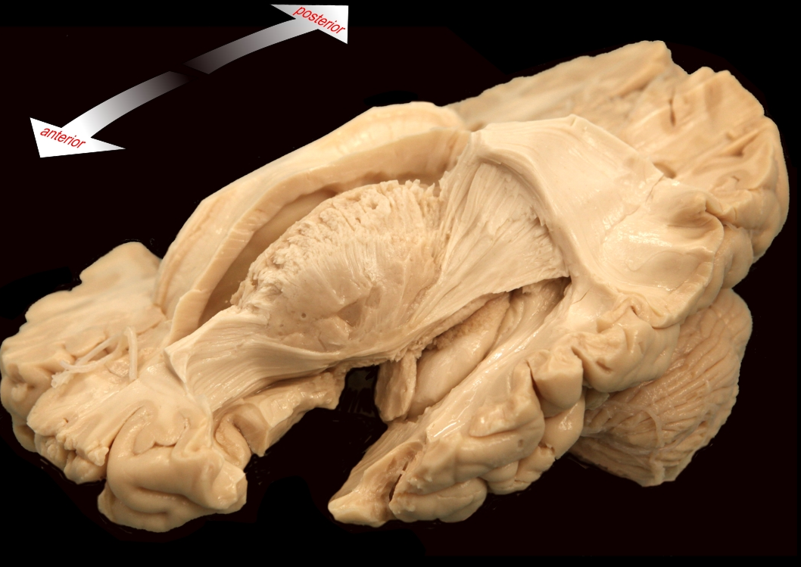
Notes:
Inferior occipitofrontal fasciculus: Association fiber tract inferior to the insula that connects frontal, temporal, and occipital lobes.

Slide 14
Notes:
Arcuate Fasciculus: Association fiber tract curving above the insula. Another name for the superior longitudinal fasciculus (though typically the posterior, diving portion of the SLF).

Slide 15
Notes:
Superior longitudinal fasciculus: Association fiber tract superior to the insula, connects Broca’s and Wernike’s. Also called the arcuate fasciculus (though arcuate fasciculus is usually the posterior diving part)

Slide 16
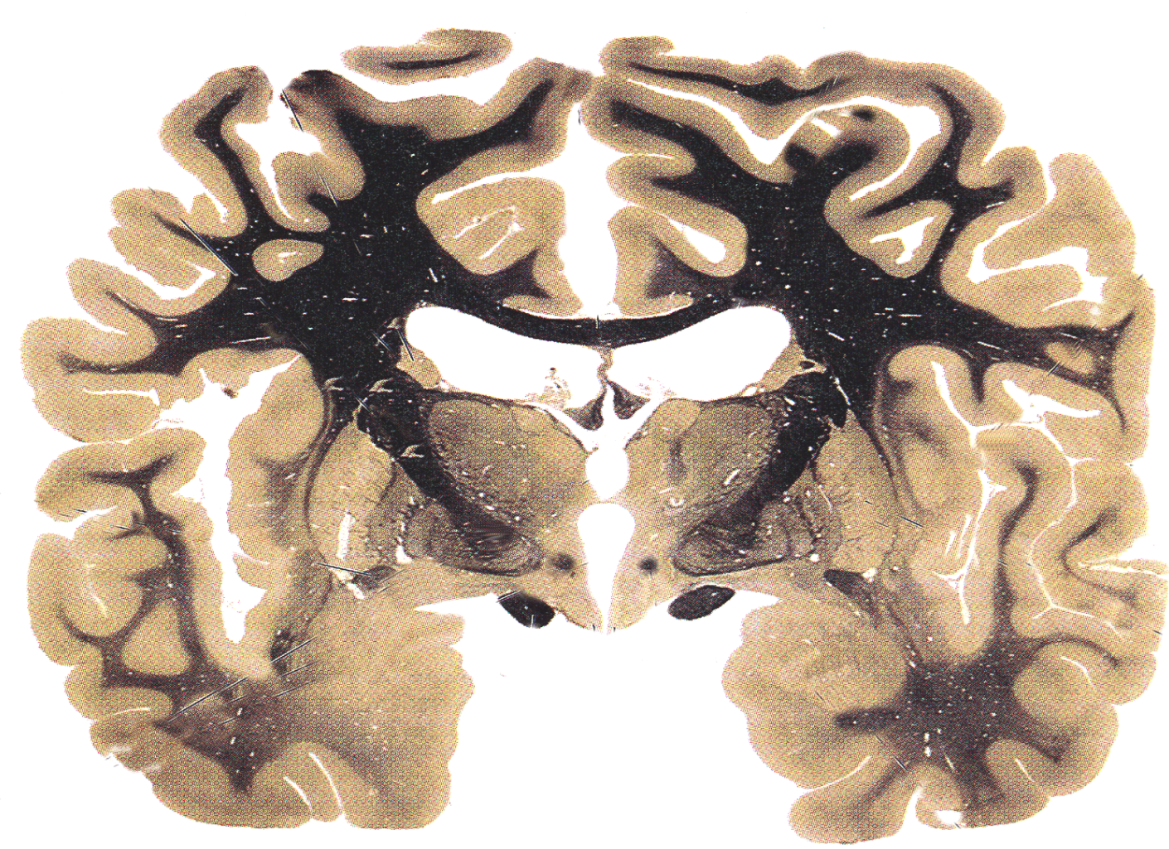
Notes:
Cingulum: Association pathway between the cingulate gyrus and hippocampus along with a few additional structures

Slide 17
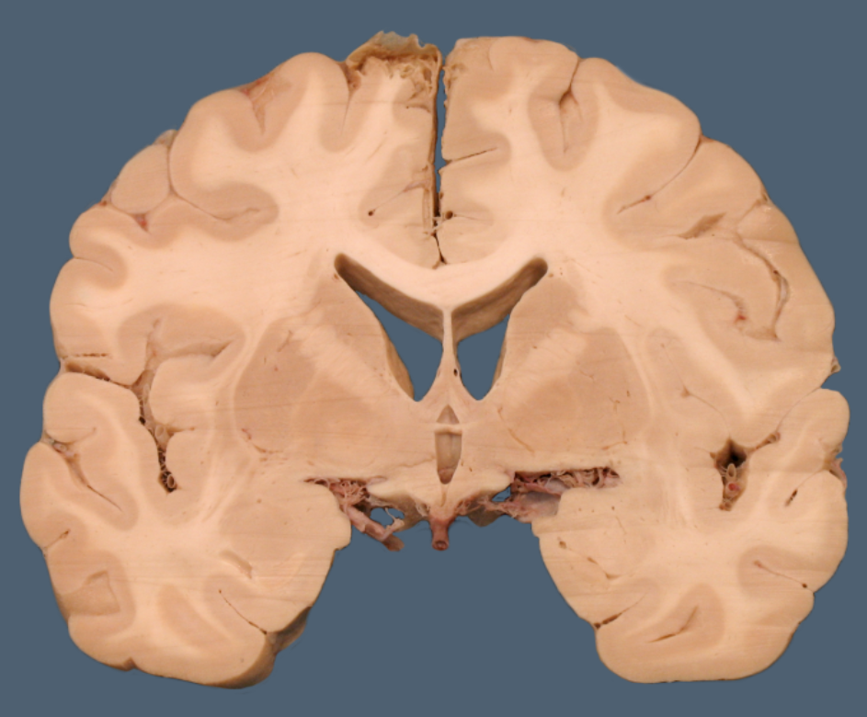
Notes:
Anterior commissure: Commissural fiber bundle at the anterior region of the brain- ie connect hemispheres
Note that the thalamus is not present because you are anterior. Helps to determine this is the anterior commissure instead of posterior

Slide 18
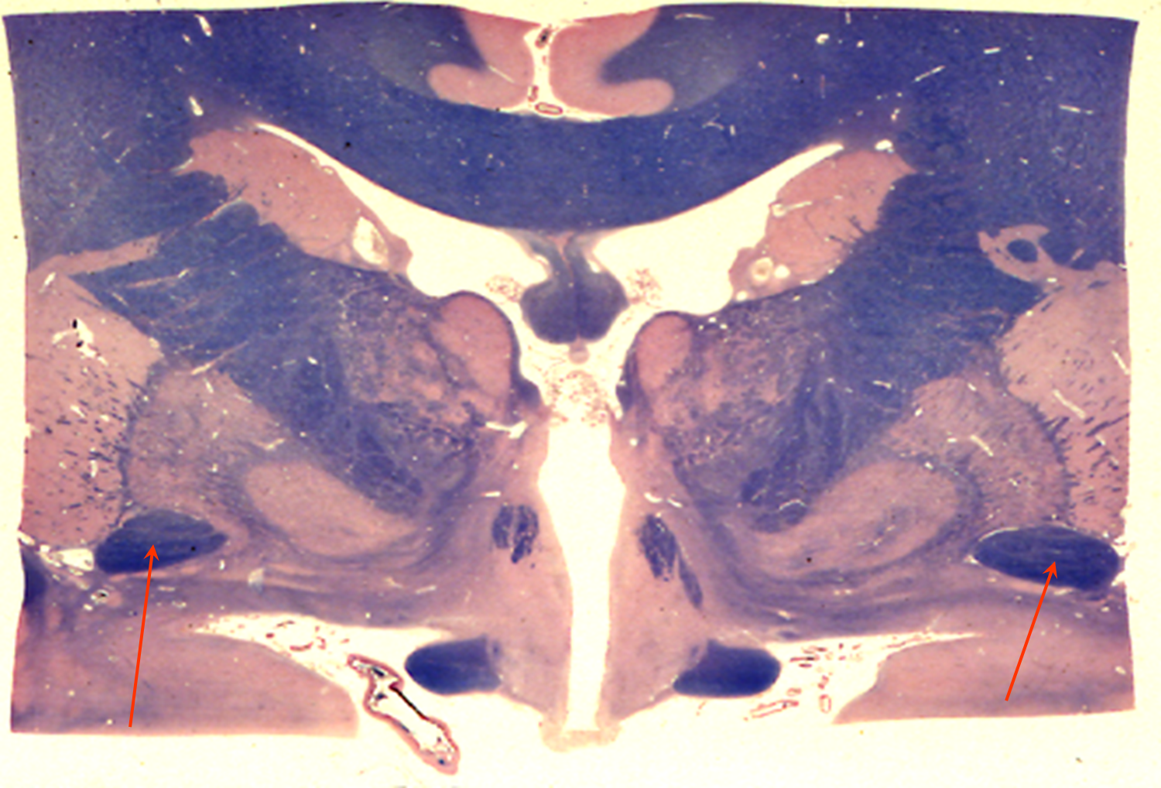
Notes:
Anterior commissure: Commissural fiber bundle at the anterior region of the brain- ie connect hemispheres

Slide 19
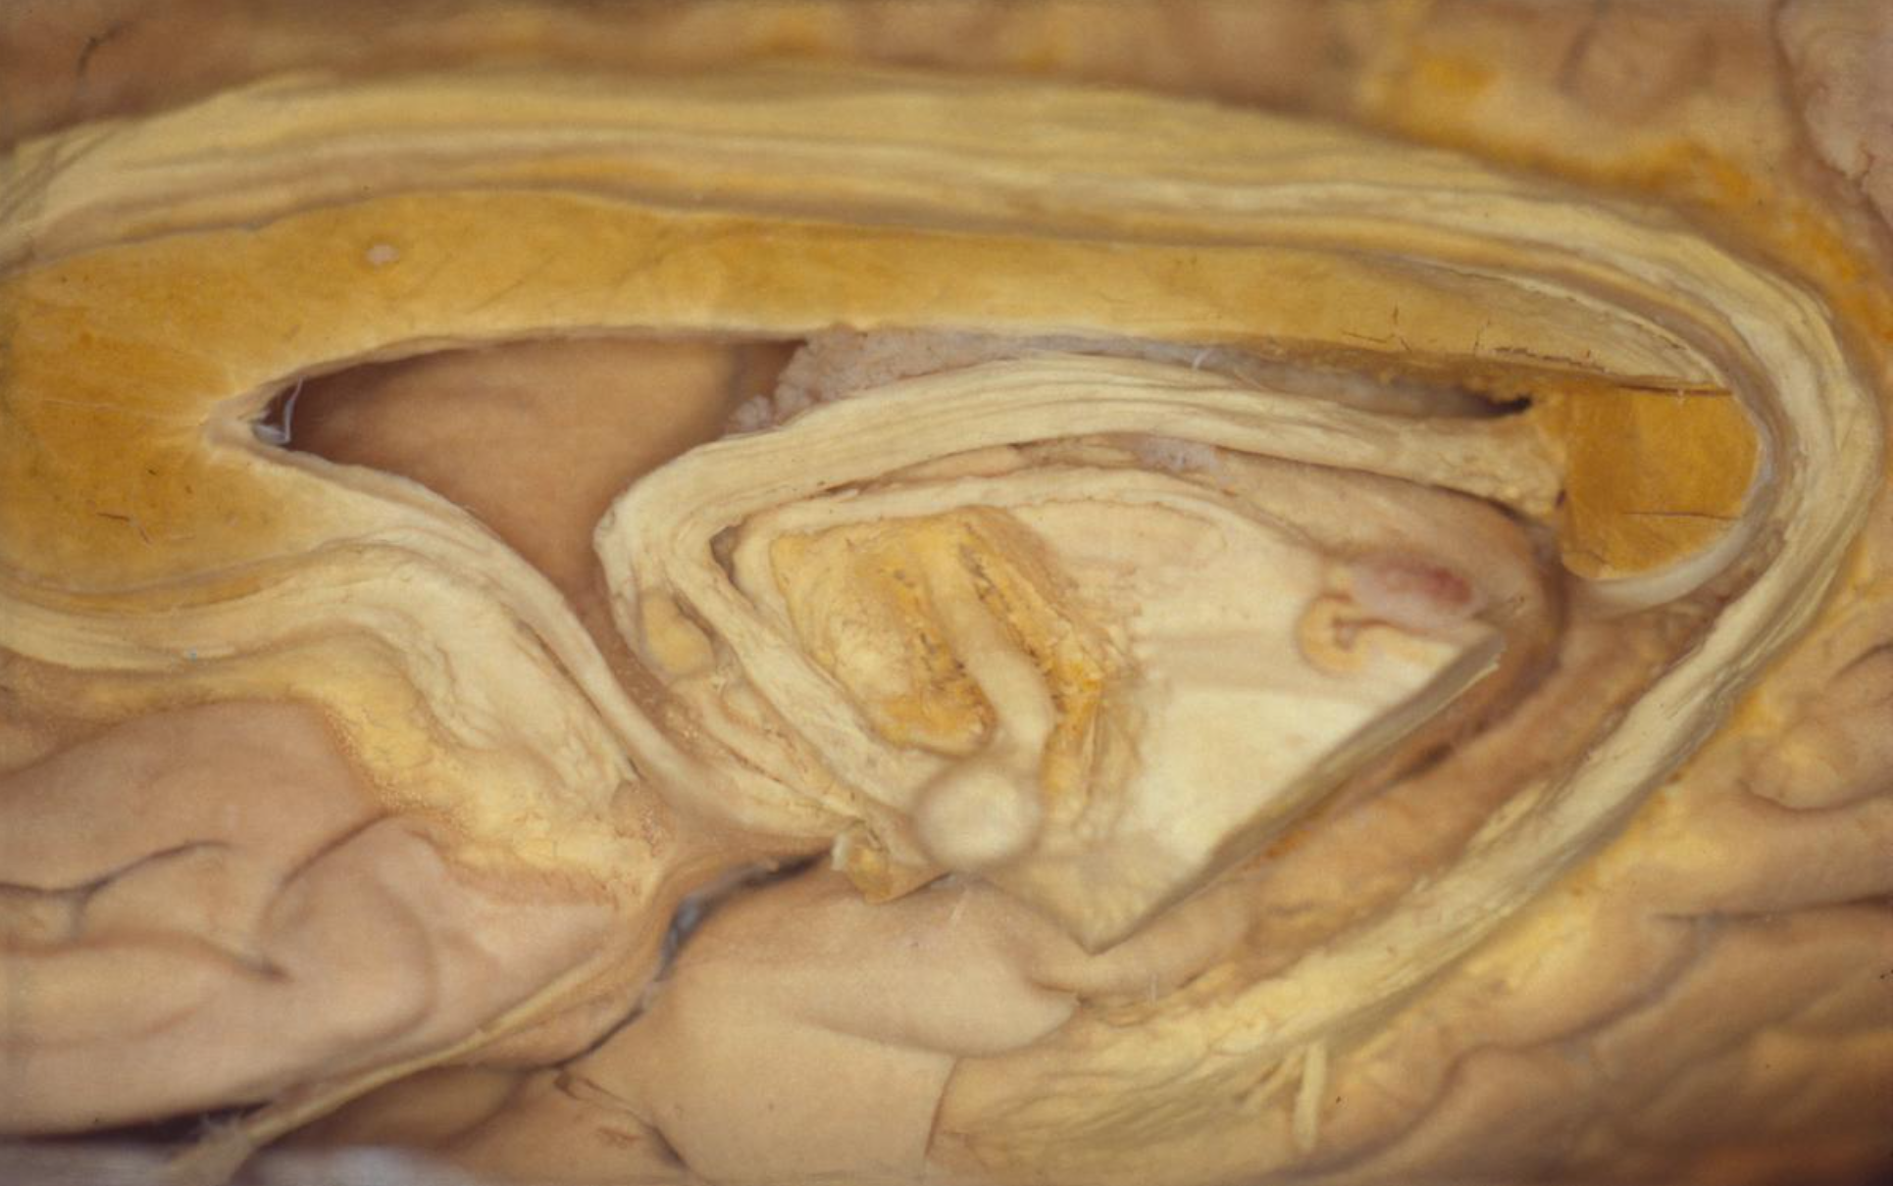
Notes:
Posterior commissure: crossing fibers involved in the visual system

Slide 20
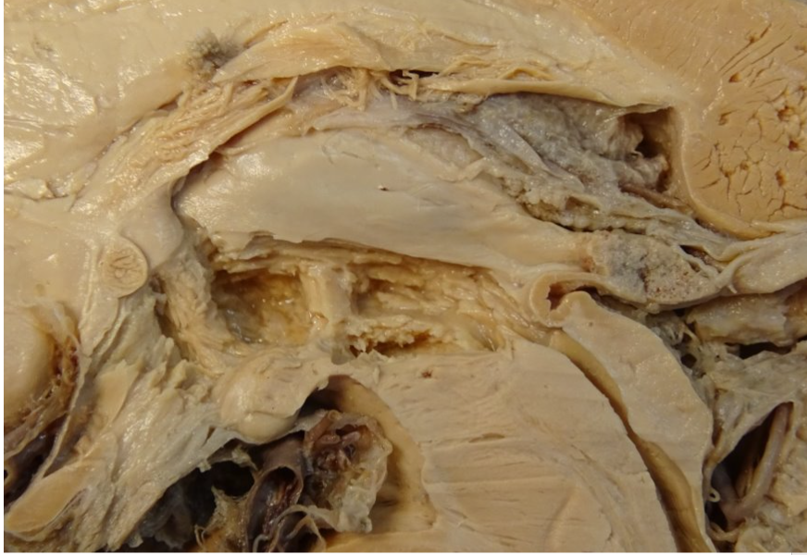
Notes:
Anterior commissure: Commissural fiber bundle at the anterior region of the brain- ie connect hemispheres

Slide 21
Notes:
Posterior commissure: crossing fibers involved in the visual system

Slide 22
Notes:
Hippocampal (fornical) commissure: Connects the 2 hippocampi.

Slide 23
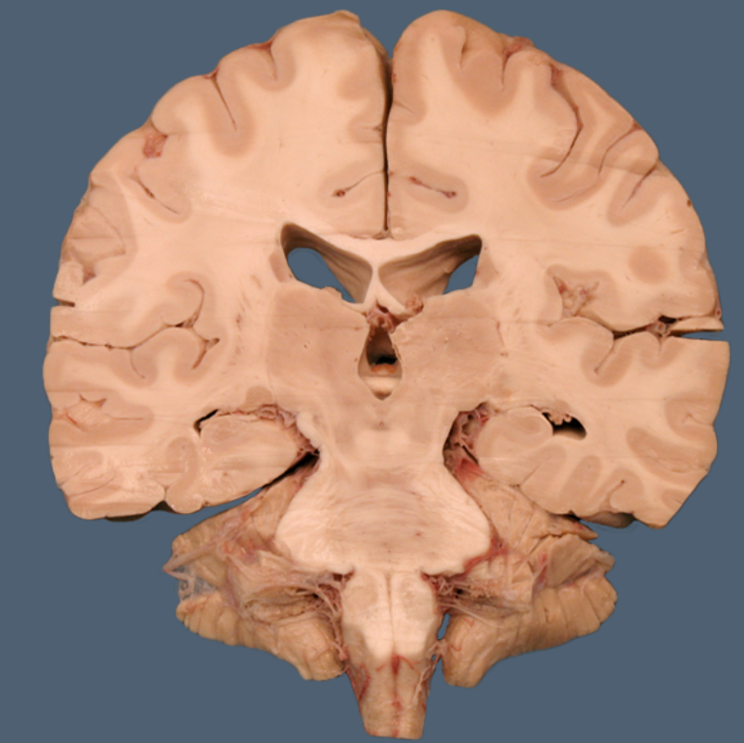
Notes:
Posterior commissure: crossing fibers involved in the visual system

Slide 24
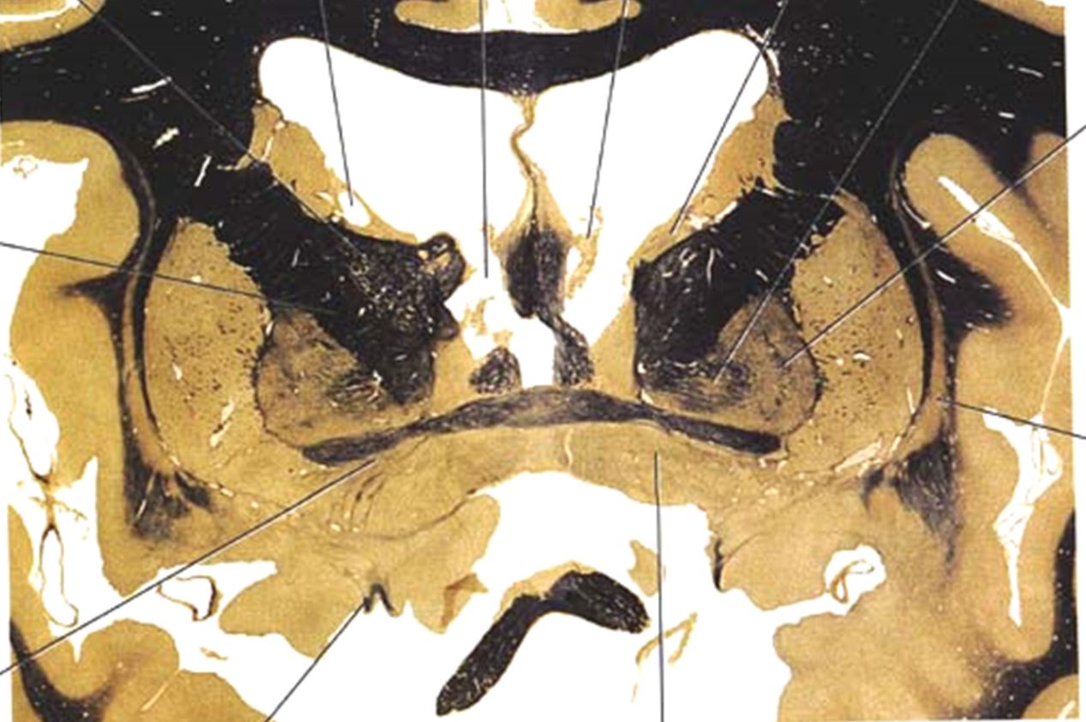
Notes:
Anterior commissure: Commissural fiber bundle at the anterior region of the brain- ie connect hemispheres

Slide 25
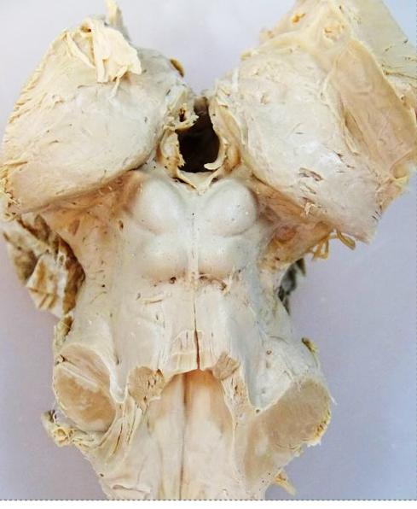
Notes:
Posterior commissure: crossing fibers involved in the visual system

Slide 26
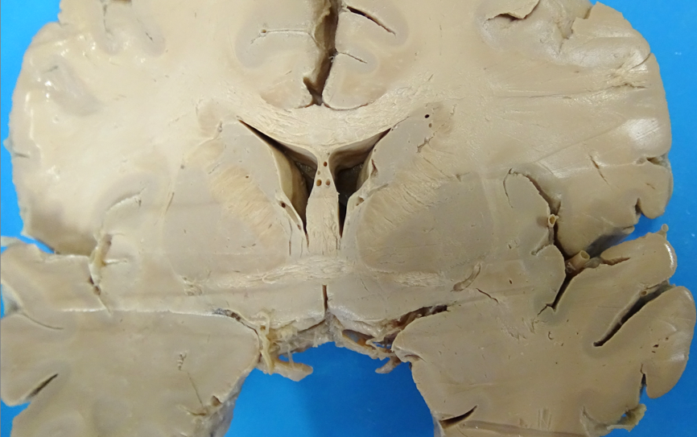
Notes:
Anterior commissure: Commissural fiber bundle at the anterior region of the brain- ie connect hemispheres

Slide 27
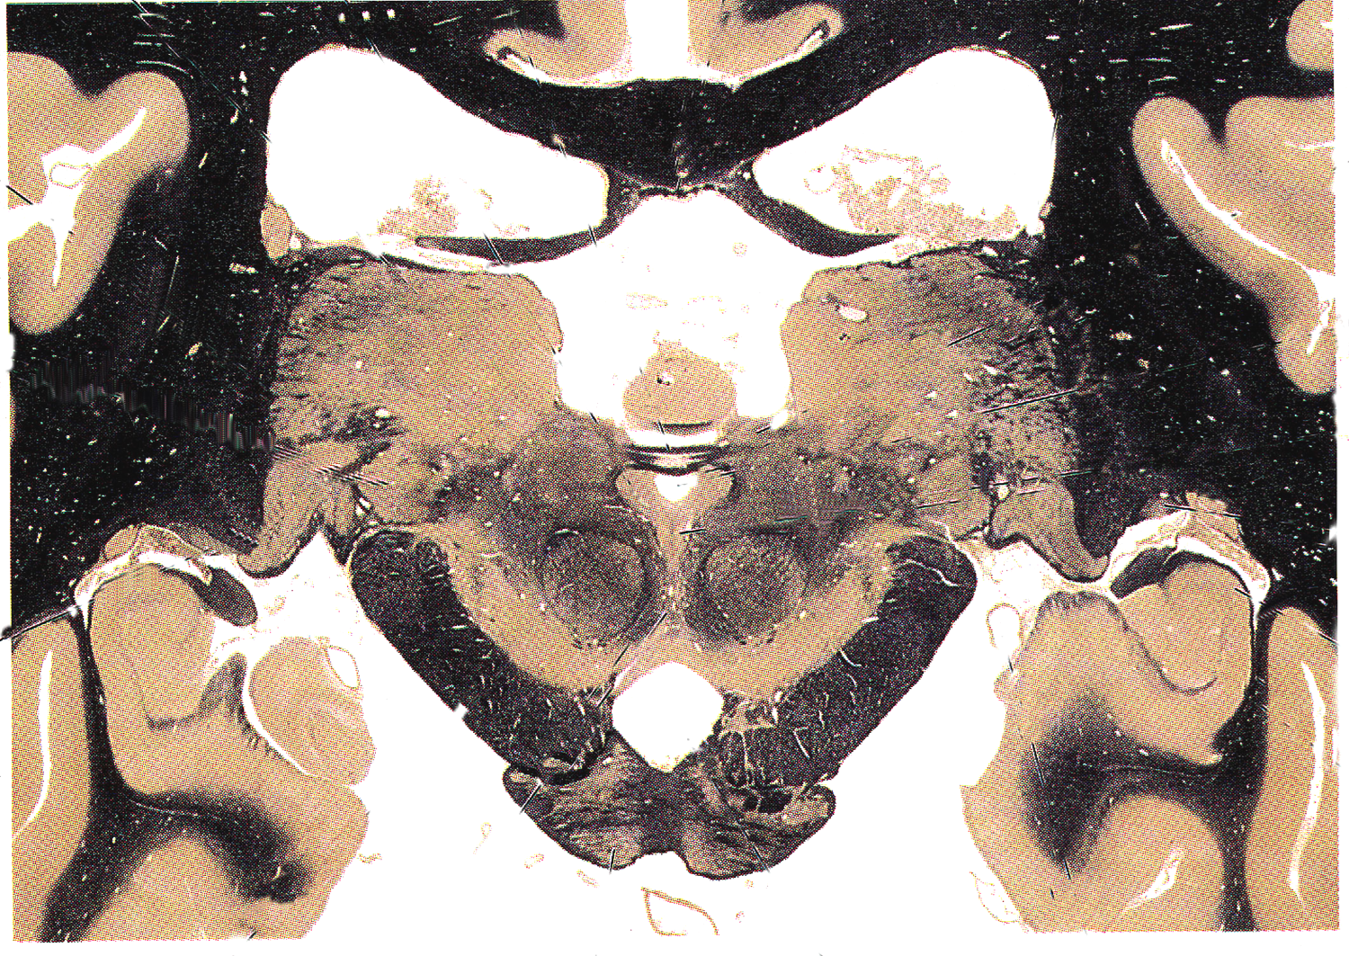
Notes:
Posterior commissure: crossing fibers involved in the visual system

