Slide 1
Lab 5: Practice ID
Brainstem Surface Anatomy
Ryan Dickerson, BSOM 2025
Mack Morgan, BSOM 2026

Slide 2
Mission Statement
SCRUBS is a student-driven initiative that aims to develop supplemental resources for current and future cohorts that will pass through Brody. Members of SCRUBS participate in a variety of sub-committees working to create resources for students, by students. These resources aim to offer unique perspectives from students that have walked in the same shoes, developing resources that we wish we had been exposed to during our time in the course.
The hope is this organization will become a staple of the Brody student body, exemplifying the unique collaborative community that Brody offers. If this is a mission that aligns with your goals and you have the desire to help those that will come behind you, as well as a goal to leave your mark on Brody as a whole, we invite you to join the team!

Slide 3
Disclaimer
The resources that are included in this document are made by students and not the faculty. As such, there is the possibility for errors in our development, although this is mitigated via a team approach to development with multiple stages of vetting. If there is a contradiction with the coursework presented within your course, please go by the course documents. Additionally, SCRUBS aims to supply supplemental resources, however these are in no way replacements to the instruction of the Brody faculty. Use these resources as a supplement, but not as your primary source for course material.

Slide 4
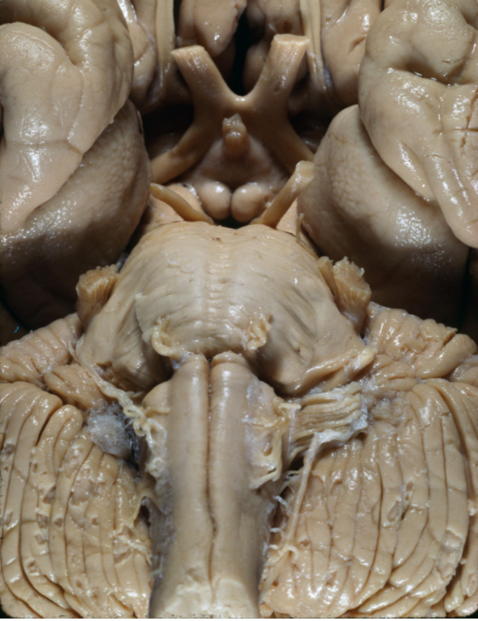
Notes:
Optic Chiasm: X-shaped structure demarcating the crossing over of each optic nerve.
Crossing fibers from the medial retinal fields (lateral visual fields)

Slide 5
Notes:
Infundibulum: Stalk connecting the hypothalamus to the posterior pituitary gland.

Slide 6
Notes:
Mammillary bodies: Hypothalamic structure related to the limbic system

Slide 7
Notes:
Oculomotor nerve: Effector limb of control of eye movements, comes between the PCA and Superior cerebellar artery

Slide 8
Notes:
CN V: Trigeminal nerve- main sensory nerve of the face

Slide 9
Notes:
Trochlear nerve CN IV: Only CN that exits posteriorly (just below inferior colliculus). Represent crossed fibers that cross in superior medullary velum.

Slide 10
Notes:
Olfactory tract: CN I pathway from the olfactory bulbs, runs in the olfactory sulcus between the gyrus rectus and medial orbital gyrus

Slide 11
Notes:
Abducens nerve: CN 6, concerned with lateral movement of the eyeballs. Exits at pontomedullary junction. Underlies facial colliculus.

Slide 12
Notes:
CN VII: Facial nerve - motor control of muscles of facial expression and taste to the anterior 2/3rds of the tongue. Exits from cerebellopontine angle.

Slide 13
Notes:
Vestibulocochlear nerve CN VIII: Exits from cerebellopontine angle. Transmits sound and equilibrium info. Through olivocochlear fibers, also transmits motor info from the superior olivary complex in the brainstem to the cochlea.

Slide 14
Notes:
Vagus/glossopharyngeal (X and IX) nerves: Exit medulla from groove between the olive and inferior cerebellar peduncle (post-olivary sulcus).

Slide 15
Notes:
Spinal accessory nerve CN XI: Rootlets emerge along posterior border of olive below vagus, exits skull via jugular foramen. Motor only that supplies traps and SCM.

Slide 16
Notes:
CNXII: hypoglossal nerve- supplies the motor control of the tongue, comes out the pre-olivary sulcus (except for palatoglossus via CN IX)

Slide 17
Notes:
Interpeduncular fossa: Space between the cerebral peduncles of the midbrain

Slide 18
Notes:
Medullary pyramids: Paired white matter structure tracts containing descending motor fibers running from the beginning of the medulla oblongata to the decussation.

Slide 19
Notes:
Olive: External brainstem structure overlying the inferior olivary nucleus

Slide 20
Notes:
Pyramidal decussation: Location of crossing corticospinal fibers from one half of the CNS to the other. Above this region, fibers for motor control to the lower body are located opposite their targets, while below this region the fibers are located on the same side as the targets

Slide 21
Notes:
Ventral median fissure: The anterior spinal artery runs through this, briefly obliterated by the pyramidal decussation.

Slide 22
Notes:
Preolivary sulcus: CN 12 exits here.

Slide 23
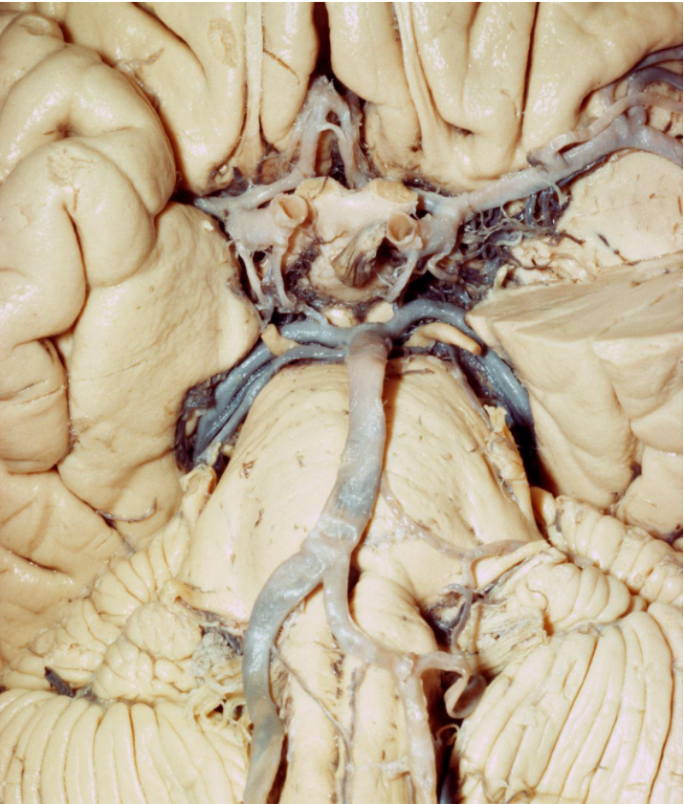
Notes:
Olfactory tract: CN I pathway from the olfactory bulbs, runs in the olfactory sulcus between the gyrus rectus and medial orbital gyrus

Slide 24
Notes:
Optic Chiasm: X-shaped structure demarcating the crossing over of each optic nerve.
Crossing fibers from the medial retinal fields (lateral visual fields)

Slide 25
Notes:
Oculomotor nerve: Effector limb of control of eye movements, comes between the PCA and Superior cerebellar artery

Slide 26
Notes:
CN V: Trigeminal nerve- main sensory nerve of the face

Slide 27
Notes:
Mammillary bodies: Hypothalamic structure related to the limbic system

Slide 28
Notes:
Medullary pyramids: Paired white matter structure tracts containing descending motor fibers running from the beginning of the medulla oblongata to the decussation.

Slide 29
Notes:
Olive: External brainstem structure overlying the inferior olivary nucleus

Slide 30
Notes:
PCA: (posterior cerebral artery): Branch of the Basilar system and not the internal carotid

Slide 31
Notes:
SCA (superior cerebellar artery): Branch of the Basilar system and not the internal carotid - so NOT part of the circle of Willis, most superior branch of the basilar- inferior to the oculomotor nerve

Slide 32
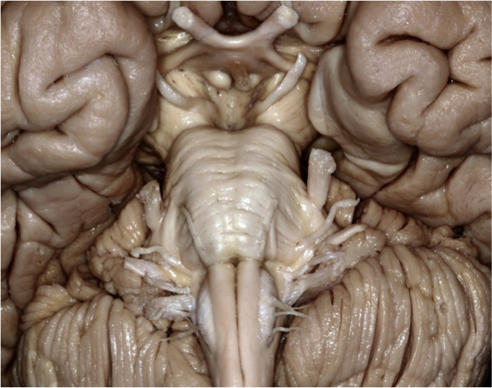
Notes:
Pons: Part of brainstem that links the thalamus and the medulla.

Slide 33
Notes:
Cerebral peduncle: Stalks that attach the cerebrum to the brainstem. Part of midbrain/mesencephalon.

Slide 34
Notes:
Oculomotor nerve: Effector limb of control of eye movements, comes between the PCA and Superior cerebellar artery

Slide 35
Notes:
Optic Chiasm: X-shaped structure demarcating the crossing over of each optic nerve.
Crossing fibers from the medial retinal fields (lateral visual fields)

Slide 36
Notes:
Mammillary bodies: Hypothalamic structure related to the limbic system

Slide 37
Notes:
Infundibulum: Stalk connecting the hypothalamus to the posterior pituitary gland.

Slide 38
SPACE
Notes:
Interpeduncular cistern: CSF-filled space between the cerebral peduncles. Superior to pontine cistern.

Slide 39
Notes:
CN V: Trigeminal nerve- main sensory nerve of the face

Slide 40
Notes:
CN VII: Facial nerve - motor control of muscles of facial expression and taste to the anterior 2/3rds of the tongue. Exits from cerebellopontine angle.

Slide 41
Notes:
Vestibulocochlear nerve CN VIII: Exits from cerebellopontine angle. Transmits sound and equilibrium info. Through olivocochlear fibers, also transmits motor info from the superior olivary complex in the brainstem to the cochlea.

Slide 42
Notes:
Medullary pyramids: Paired white matter structure tracts containing descending motor fibers running from the beginning of the medulla oblongata to the decussation.

Slide 43
Notes:
Ventral median fissure: The anterior spinal artery runs through this, briefly obliterated by the pyramidal decussation.

Slide 44
Notes:
Olive: External brainstem structure overlying the inferior olivary nucleus

Slide 45
Notes:
Preolivary sulcus: CN 12 exits here.

Slide 46
Notes:
Pyramidal decussation: Location of crossing corticospinal fibers from one half of the CNS to the other. Above this region, fibers for motor control to the lower body are located opposite their targets, while below this region the fibers are located on the same side as the targets

Slide 47
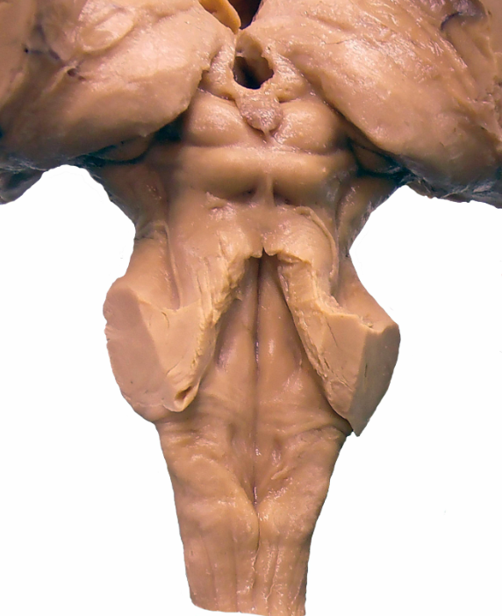
Notes:
Pineal gland: Produces melatonin. Part of epithalamus, projects into the superior cistern.

Slide 48
Notes:
Superior colliculus of the
Tectum/Quadrangular plate: Superior and Inferior colliculi- related to reflexes in vision and hearing respectively

Slide 49
Notes:
Inferior colliculus of the
Tectum/Quadrangular plate: Superior and Inferior colliculi- related to reflexes in vision and hearing respectively

Slide 50
Notes:
MGN (Medial geniculate nucleus): Relay nucleus for auditory information, receives information from the brachium of the inferior colliculus

Slide 51
Notes:
Trochlear nerve CN IV: Only CN that exits posteriorly (just below inferior colliculus). Represent crossed fibers that cross in superior medullary velum.

Slide 52
Notes:
Inferior brachium: Transmits fibers from inferior colliculus to ipsilateral MGB and superior colliculus.

Slide 53
Notes:
Obex: This is the inferior portion of the 4th ventricle in which it narrows to form the central canal

Slide 54
Notes:
Posterior median sulcus: Separates the two posterior funiculi, surrounded on either side by the gracile funiculi.

Slide 55
Notes:
Gracile Fasciculus: Fiber pathway for primary sensory fibers coming from the lower limbs along the ipsilateral sides

Slide 56
Notes:
Gracile tubercle: Location of the cell bodies of secondary sensory neurons from the lower limb

Slide 57
Notes:
Cuneate fasciculus: Fiber pathway for primary sensory fibers coming from the upper limbs along the ipsilateral side

Slide 58
Notes:
Cuneate Tubercle: Location of the cell bodies of secondary sensory neurons from the upper limb

Slide 59
Notes:
Vagal trigone: External brainstem structure in the rhomboid fossa overlying the nuclei for CN X (swelling formed by dorsal motor nucleus of the vagus)

Slide 60
Notes:
Stria medullaris: Fiber bundle that crosses the rhomboid fossa that roughly indicates the separation of the pons superiorly and the medulla inferiorly

Slide 61
Notes:
Fourth ventricle: Ventricle that communicates with the cerebral aqueduct superiorly and the central canal of the spinal cord inferiorly. CSF escapes from here via the foramina of Luschka or Magendie.

Slide 62
Notes:
Facial colliculus: Visible structure overlying the abducens and facial nuclei

Slide 63
Notes:
Medial eminence: Medial swelling of rhomboid fossa that contains the hypoglossal and vagal trigones and the facial colliculus (CN 6 & 7)

Slide 64
Notes:
Superior medullary velum: Located at the superior recess and forms part of the roof of the fourth ventricle.

Slide 65
Notes:
Hypoglossal trigone: External brainstem structure in the rhomboid fossa overlying the nuclei for CN XII.

Slide 66
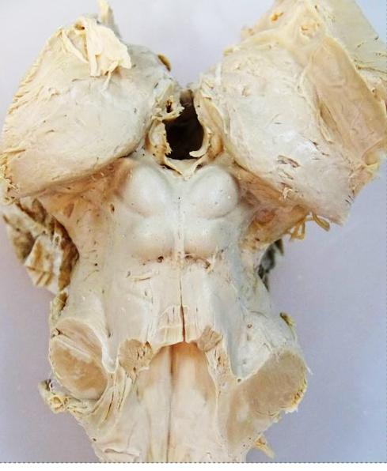
Notes:
Superior colliculus of the
Tectum/Quadrangular plate: Superior and Inferior colliculi- related to reflexes in vision and hearing respectively

Slide 67
Notes:
Inferior colliculus of the
Tectum/Quadrangular plate: Superior and Inferior colliculi- related to reflexes in vision and hearing respectively

Slide 68
Notes:
Inferior brachium: Transmits fibers from inferior colliculus to ipsilateral MGB and superior colliculus.

Slide 69
Notes:
MGN (Medial geniculate nucleus): Relay nucleus for auditory information, receives information from the brachium of the inferior colliculus

Slide 70
Notes:
Trochlear nerve CN IV: Only CN that exits posteriorly (just below inferior colliculus). Represent crossed fibers that cross in superior medullary velum.

Slide 71
Notes:
Superior medullary velum: Located at the superior recess and forms part of the roof of the fourth ventricle.

Slide 72
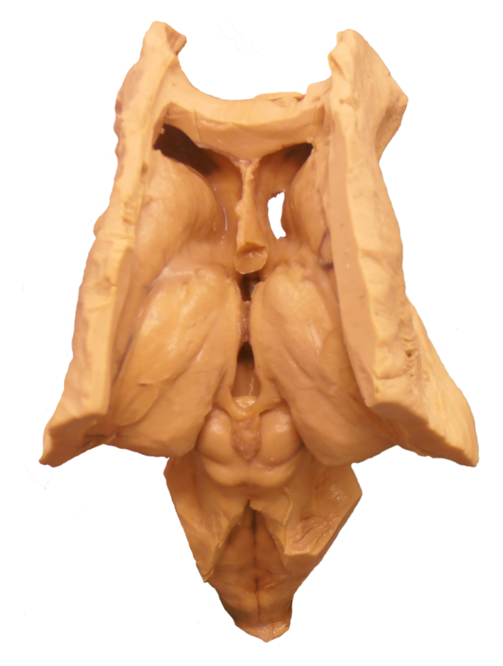
Notes:
Pineal gland: Produces melatonin. Part of epithalamus, projects into the superior cistern.

Slide 73
Notes:
Superior colliculus of the
Tectum/Quadrangular plate: Superior and Inferior colliculi- related to reflexes in vision and hearing respectively

Slide 74
Notes:
Inferior colliculus of the
Tectum/Quadrangular plate: Superior and Inferior colliculi- related to reflexes in vision and hearing respectively

Slide 75
Notes:
Superior medullary velum: Located at the superior recess and forms part of the roof of the fourth ventricle.

Slide 76
Notes:
Obex: This is the inferior portion of the 4th ventricle in which it narrows to form the central canal

Slide 77
Notes:
Gracile tubercle: Location of the cell bodies of secondary sensory neurons from the lower limb

Slide 78
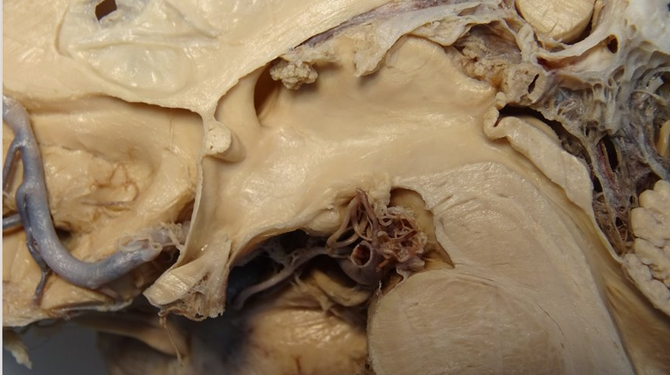
Notes:
Cerebral Aqueduct: This narrow structure connects the third ventricle and fourth ventricle, allowing CSF to maintain its proper path. Blockages, usually due to developmental defects, can lead to hydrocephalus

Slide 79
Notes:
Tectum/Quadrangular plate: Superior and Inferior colliculi- related to reflexes in vision and hearing respectively

Slide 80
Notes:
Pons: Part of brainstem that links the thalamus and the medulla.

Slide 81
Notes:
Cerebral peduncle (pes ped): Stalks that attach the cerebrum to the brainstem. Part of midbrain/mesencephalon.

Slide 82
Notes:
Fourth ventricle: Ventricle that communicates with the cerebral aqueduct superiorly and the central canal of the spinal cord inferiorly. CSF escapes from here via the foramina of Luschka or Magendie.

