Slide 1
Higher level multiple choice practice questions
Ryan Dickerson, BSOM 2025

Slide 2
Mission Statement
SCRUBS is a student-driven initiative that aims to develop supplemental resources for current and future cohorts that will pass through Brody. Members of SCRUBS participate in a variety of sub-committees working to create resources for students, by students. These resources aim to offer unique perspectives from students that have walked in the same shoes, developing resources that we wish we had been exposed to during our time in the course.
The hope is this organization will become a staple of the Brody student body, exemplifying the unique collaborative community that Brody offers. If this is a mission that aligns with your goals and you have the desire to help those that will come behind you, as well as a goal to leave your mark on Brody as a whole, we invite you to join the team!

Slide 3
Disclaimer
The resources that are included in this document are made by students and not the faculty. As such, there is the possibility for errors in our development, although this is mitigated via a team approach to development with multiple stages of vetting. If there is a contradiction with the coursework presented within your course, please go by the course documents. Additionally, SCRUBS aims to supply supplemental resources, however these are in no way replacements to the instruction of the Brody faculty. Use these resources as a supplement, but not as your primary source for course material.

Slide 4
All of the following are multiple choice (A-E) with answers in the notes. For practice, set a 40 sec timer as a maximum and don't return to previous questions.
Some questions have references in the notes, or even indicate that there is a reference image UNDER the lab image, so make sure to check the notes

Slide 5
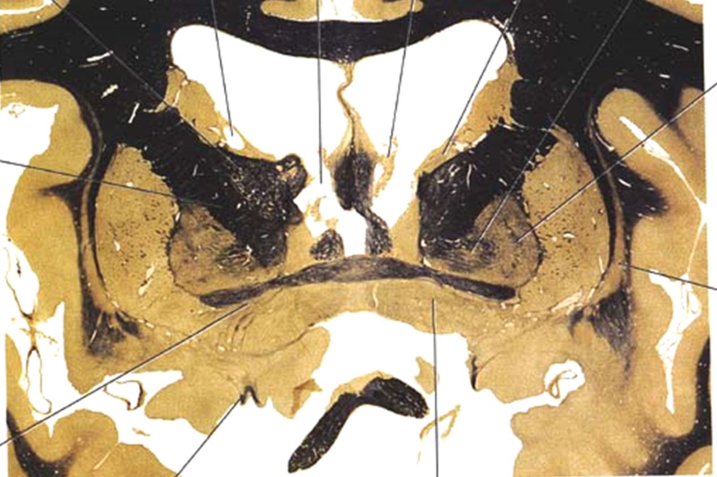
Damage to this structure can result in loss of what neurotransmitter involved in the consciousness system
Norepinephrine
Glutamate
GABA
Serotonin
Acetylcholine
Notes:
E: Structure is the basal forebrain (contains the basal nucleus of meynert)
Ach is involved in inhibiting the reticular nucleus, this allows for the thalamus to be disinhibited and active (increased arousal and attention)

Slide 6
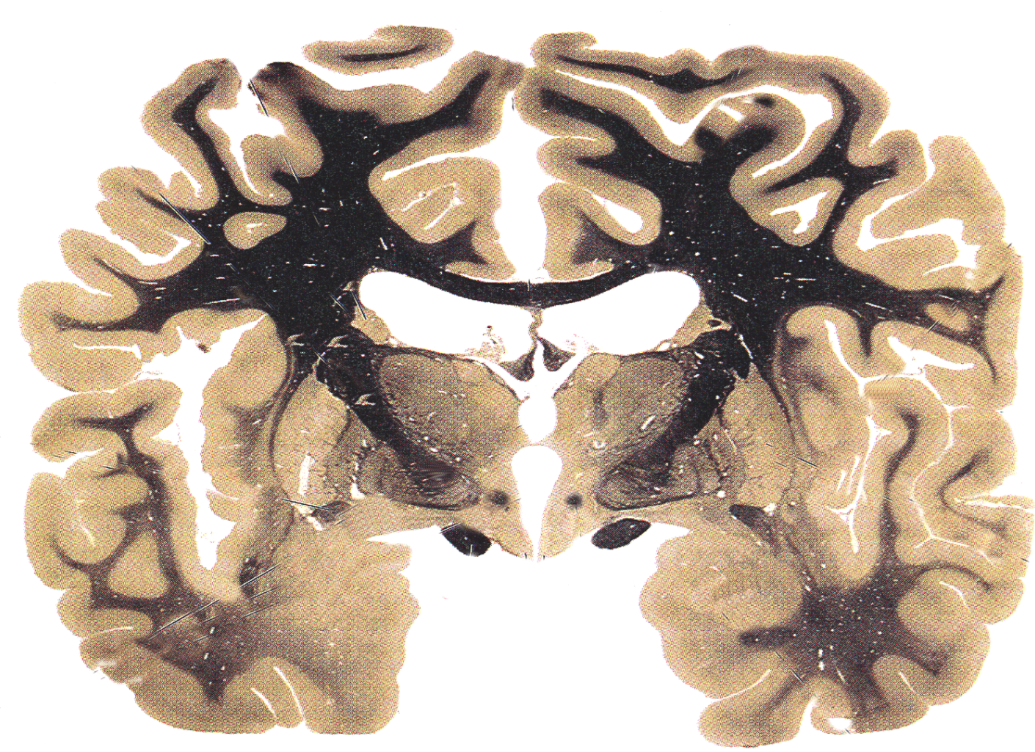
Damage to this structure will likely cause:
Difficulty encoding memory and attention deficits
Retrograde amnesia
Anterograde amnesia
Chorea
Addictive tendencies
Notes:
C
Indicated structure is the dorsomedial nucleus
Pg. 3 thalamus handout (Medial thalamic division)

Slide 7
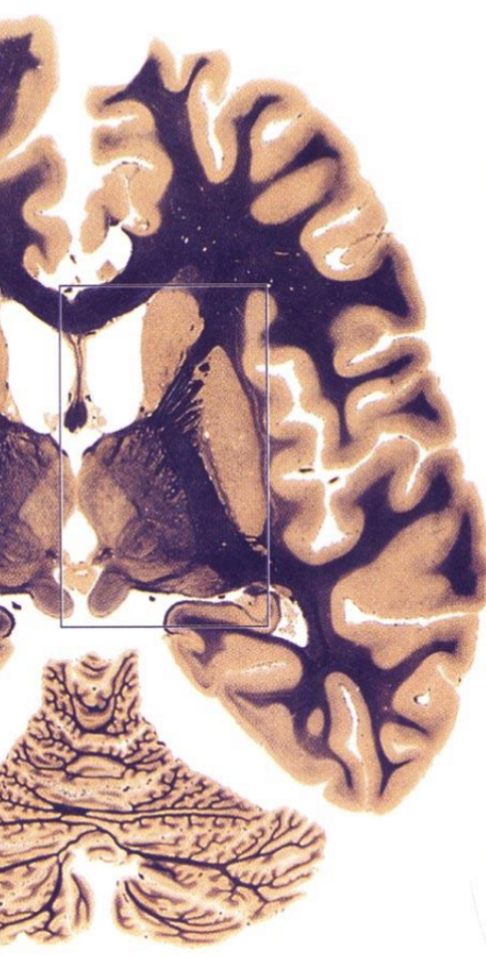
What Fibers run through this part of the internal capsule
Frontopontine fibers and communicating fibers between thalamus and cingulate gyrus
Corticospinal fibers and communicating fibers between the VPL/VPM and somatosensory cortices
Frontopontine fibers and communications between VA/VL and motor cortices
Parietal corticopontine fibers
Thalamomamillary fibers
Notes:
B: Structure is the posterior limb of the IC
Pg 6: Thalamus handout

Slide 8
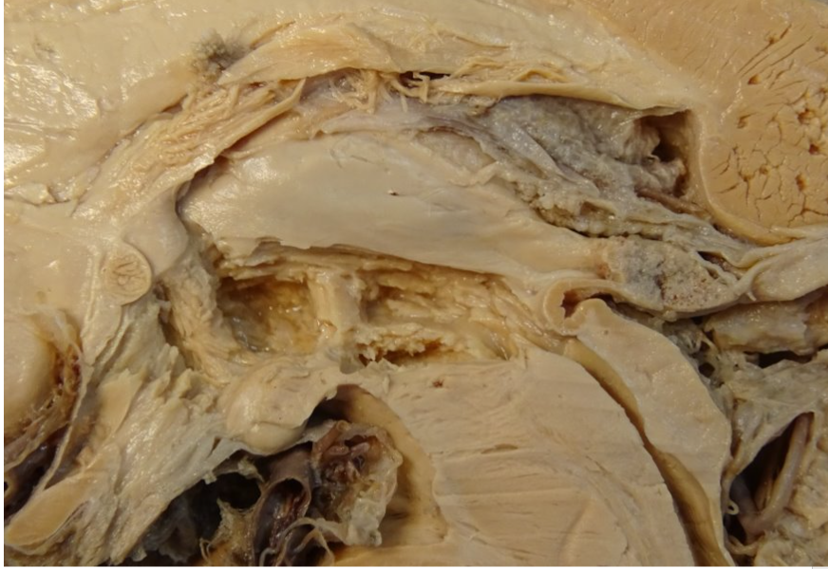
Indicated structure is derived from the:
Diencephalon
Mesencephalon
Metencephalon
Rhomboid Lip
Telencephalon
Notes:
E
Telencephalon; this is the lamina terminalis (anterior border of the third ventricle)

Slide 9
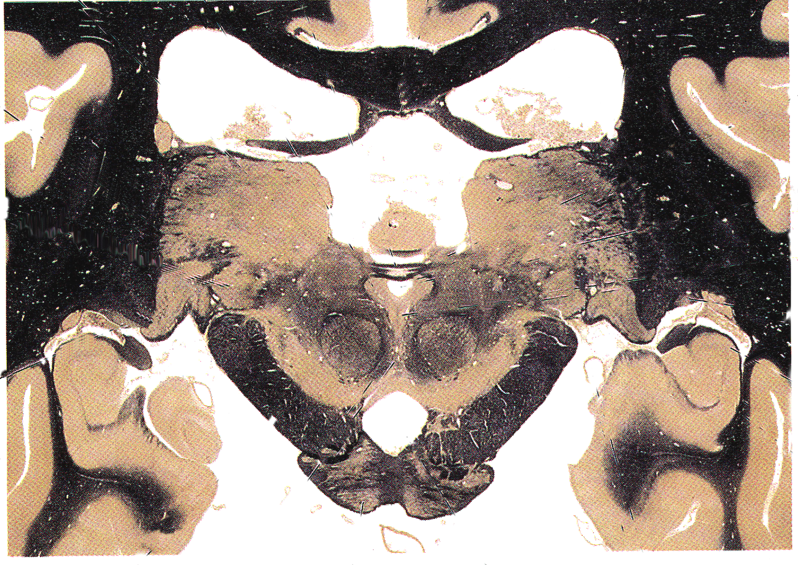
Damage to the indicated structure would inhibit activation of what muscle in voluntary conjugate gaze?
Left superior oblique
Bilateral inferior rectus
Ipsilateral inferior oblique
Bilateral superior rectus
Bilateral lateral rectus
Notes:
D
In voluntary vertical gaze, the RiMLF sends contralateral signal through the posterior commissure (labled structure) to activate the superior rectus. It is the only fiber supplying conjugate gaze that goes through the posterior commissure. Taking out the posterior commissure takes out the contralateral fibers coming from both RiMLF’s.
See conjugate gaze lecture

Slide 10
What Fibers run through this part of the internal capsule
Frontopontine fibers and communicating fibers between thalamus and cingulate gyrus
Corticospinal fibers and communicating fibers between the VA/VL and motor cortices
Frontopontine fibers and communications between VA/VL and motor cortices
Parietal corticopontine fibers
Thalamomamillary fibers
Notes:
D: Structure is the retrolenticular limb of the IC
Pg 6: Thalamus handout

Slide 11
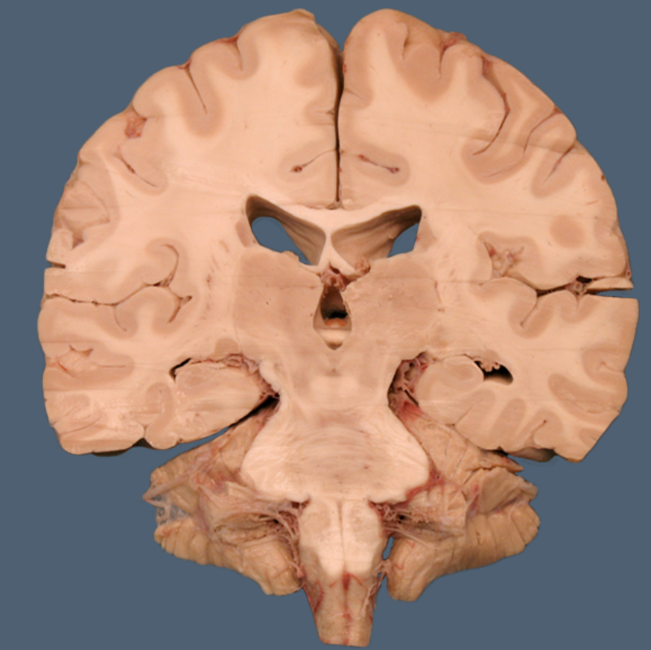
The indicated structure communicates directly with:
Mammillary bodies
Globus pallidus
Septal nuclei
Caudate nucleus
Entorhinal cortex
Notes:
E
This is the cingulum
Connects the primary limbic cortex (cingulate gyrus) and the hippocampus (via entorhinal cortex)

Slide 12
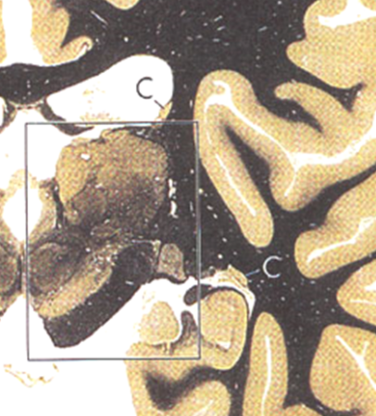
Damage to the indicated structure would result in:
Grey Matter
Cataplexy
Seizure
Inhibited memory retention
Decreased arousal
Increased arousal and attention
Notes:
E
This is the reticular nucleus
It has a role in inhibiting the thalamus from sending signals (Dr. Rays lecture)

Slide 13
Blockage of this structure would cause
Chorea
Parkinsons
Dejerine-Roussy Syndrome
Non-communicating neurocephalus
Hemiballismus
Notes:
D)
Structure is the foramen of monro
*Communicating is caused by damage to the arachnoid granules, but blockage here keeps from communicating outside of the ventricles

Slide 14
Indicated structure is a:
Auditory relay nucleus
Visual association nucleus
Auditory association nucleus
Motor inhibitory nucleus
Visual relay nucleus
Notes:
A
MGN
Pg 71 Lab manual

Slide 15
Indicated structure is a:
Auditory relay nucleus
Visual association nucleus
Auditory association nucleus
Motor inhibitory nucleus
Visual relay nucleus
Notes:
E:
Lateral geniculate nucleus
Pg 71 lab manual

Slide 16
What fibers run through this structure
Olfactory fibers from lateral olfactory stria
Occipital communications
Olfactory fibers from the medial olfactory stria
Hippocampal communications
Amygdaloid communications
Notes:
C - anterior commissure
Throw back to olfactory material but still could be tested (Smith asked the Q in the coursepack)

Slide 17
Indicated structure communicates with:
Mamillary bodies and cortex
Infundibulum and thalamus
Habenular nuclei and thalamus
Mammillary bodies and thalamus
Hippocampus and fornix
Notes:
D
Mammillothalamic tract

Slide 18
The indicated structure is a:
Relay nucleus that communicates with the primary motor cortex
Association cortex communicating with the pre-frontal cortex
Relay nucleus communicating with the primary limbic cortex
Association cortex communicating with the primary limbic cortex
Relay nucleus communicating with the primary somatosensory cortex
Notes:
B: Dorsomedial nucleus
Lab manual pg 70

Slide 19
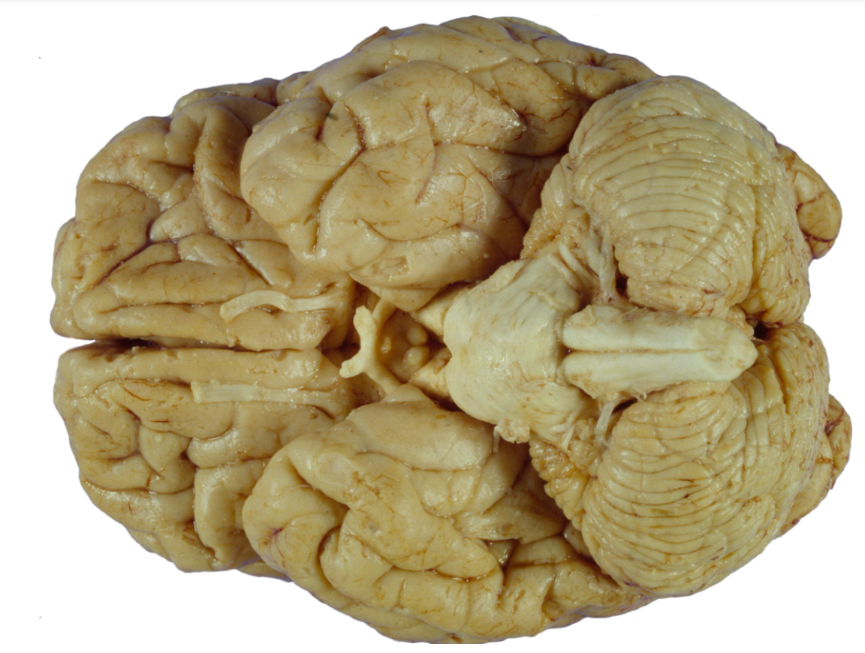
What lies deep to the indicated structure?
Hippocampus
Lateral geniculate nucleus
Ventral pallidum
Amygdala
Mammillary bodies
Notes:
D
Amygdala underlies the uncus

Slide 20
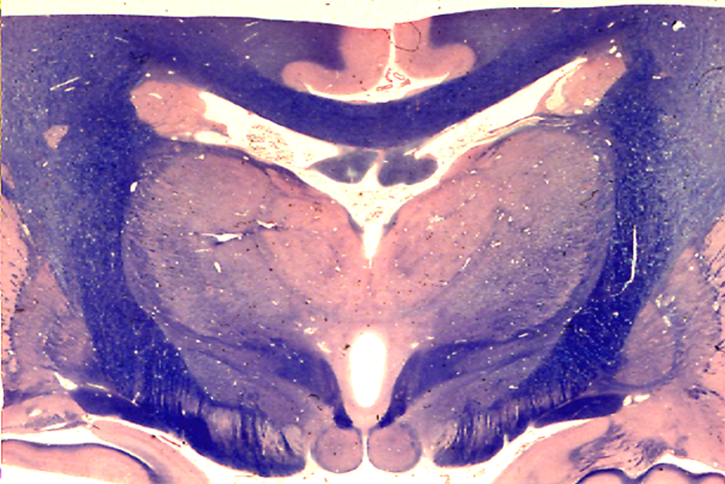
Indicated structure communicates with:
Mamillary bodies and cortex
Infundibulum and thalamus
Habenular nuclei and thalamus
Mammillary bodies and thalamus
Hippocampus and fornix
Notes:
D
Mammillothalamic tract

Slide 21
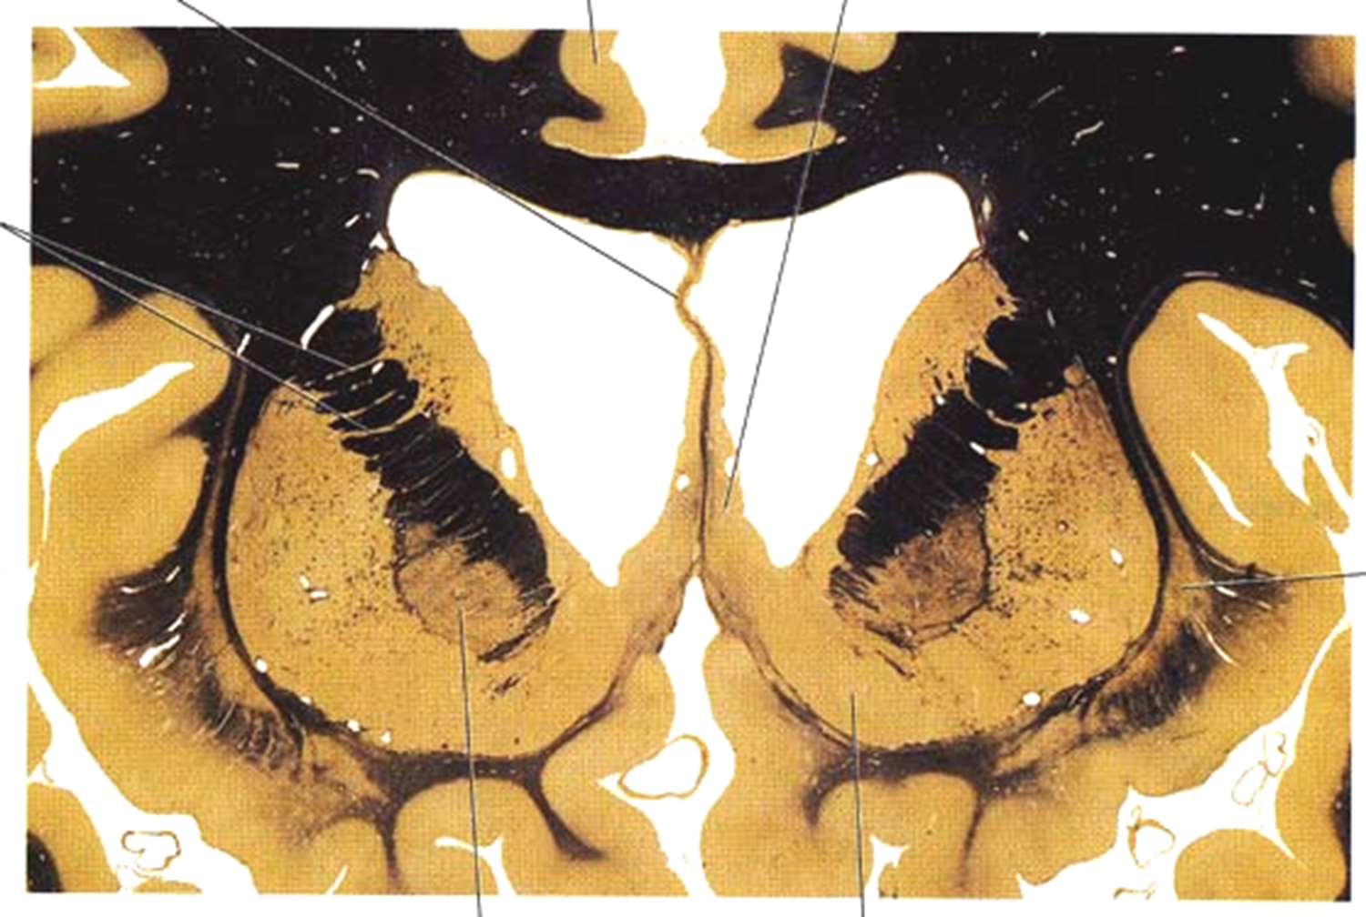
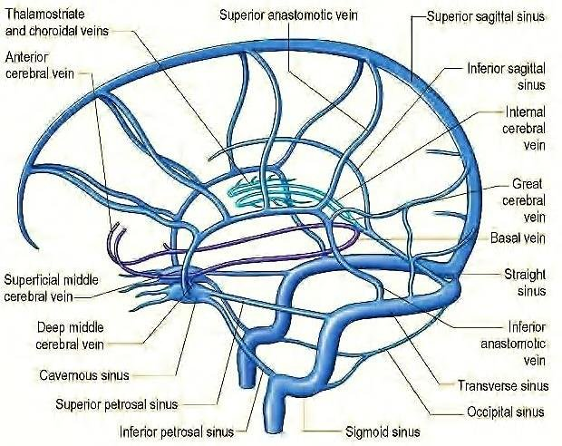
This vessel contributes directly to:
Basal vein of rosenthal
Choroidal artery
Recurrent artery of heubner
Great vein of Galen
Internal cerebral vein
Notes:
E: Structure is the thalamostriate vein
*Reference behind the image, just move it to the side to view

Slide 22
The indicated structure releases what neurotransmitter
Histamine
Norepi
Ach
Dopamine
Serotonin
Notes:
D
Substantia nigra

Slide 23
Indicated structure receives what info:
Contralateral facial sensation
Ipsilateral body sensation
Ipsilateral facial sensation
Contralateral motor output
Contralateral body sensation
Notes:
A
Structure is the VPM
This nucleus conforms to the centromedian nucleus (located just to the left of this structure)

Slide 24
This structure is a major connection between limbic structures and the:
Hippocampus
Amygdala
Dentate nucleus
Substantia nigra
Subthalamic nucleus
Notes:
B : Structure is the stria terminalis
Thalamus handout Pg 2

Slide 25
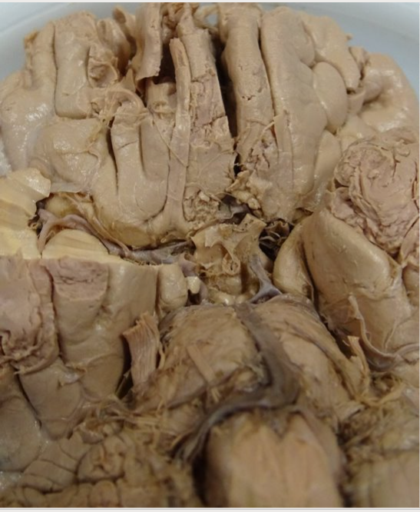
Information traveling through this structure is sent to which nucleus of the amygdala?
Centromedial
Dorsomedial
Basolateral
Medial
Pulvinar
Notes:
D
Lateral olfactory stria
Communicates with the medial sub nucleus
*Pg 3 Limbic system handout

Slide 26
The indicated structure connects the:
Hypothalamus and amygdala
Entorhinal cortex and septal nuclei
Hippocampus and mammillary bodies
Mammillary bodies and tegmentum
Amygdala and dorsomedial nuclei
Notes:
C
Indicated structure is the fornix
Lab manual pg. 76

Slide 27
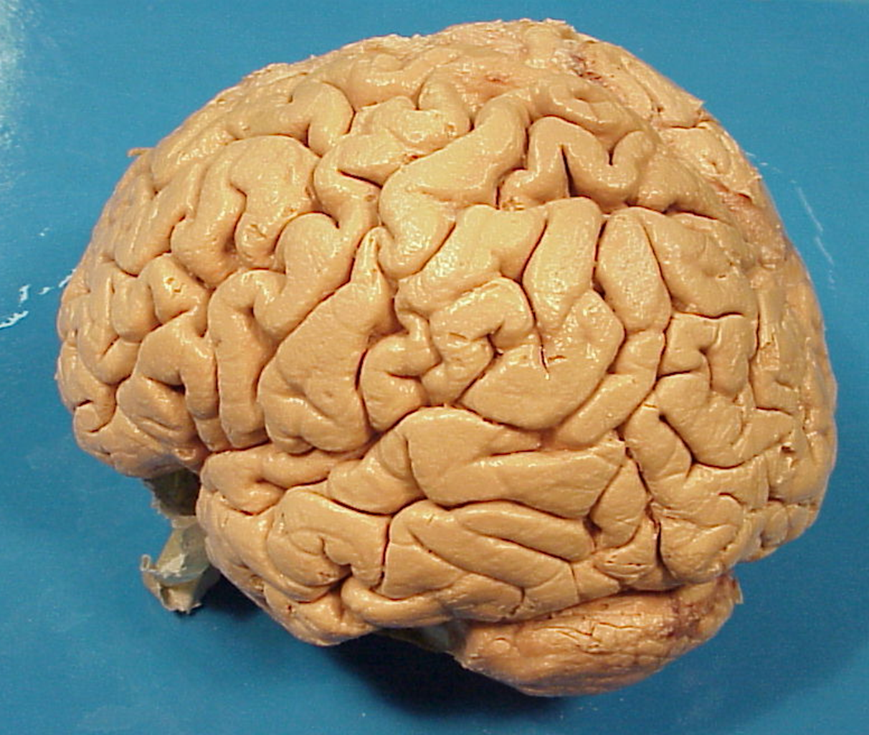
This region of the cortex has what function in eye control
Voluntary Vertical Gaze
Reflexive Vertical Gaze
Voluntary Horizontal Gaze
Smooth Pursuit Initiation
Vestibulo-ocular reflex
Notes:
Structure:
Angular gyrus
**Location of both the MT and MLT**
D: The MT/MLT and PEF all have a role in smooth pursuit initiation

Slide 28
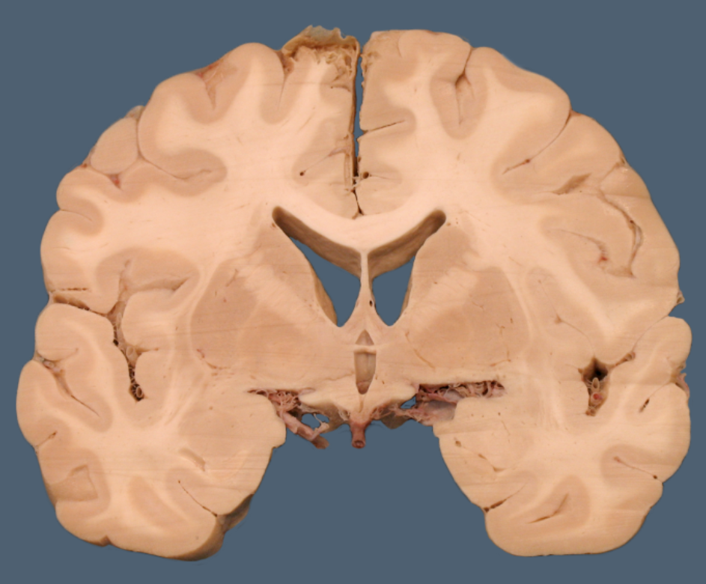
Indicated structure has a major role in:
Semantic memory encoding
Pituitary activation
Posterior commisure communications
Episodic memory formation
Fear response
Notes:
E
This is the amygdala

Slide 29
Indicated structure communicates between:
Mammillary bodies and septal nuclei
Mammillary bodies and thalamus
Hippocampus and mammillary bodies
Hippocampus and dorsomedial nucleus
Anterior thalamic nuclei and amygdala
Notes:
C
This is the Fornix

Slide 30
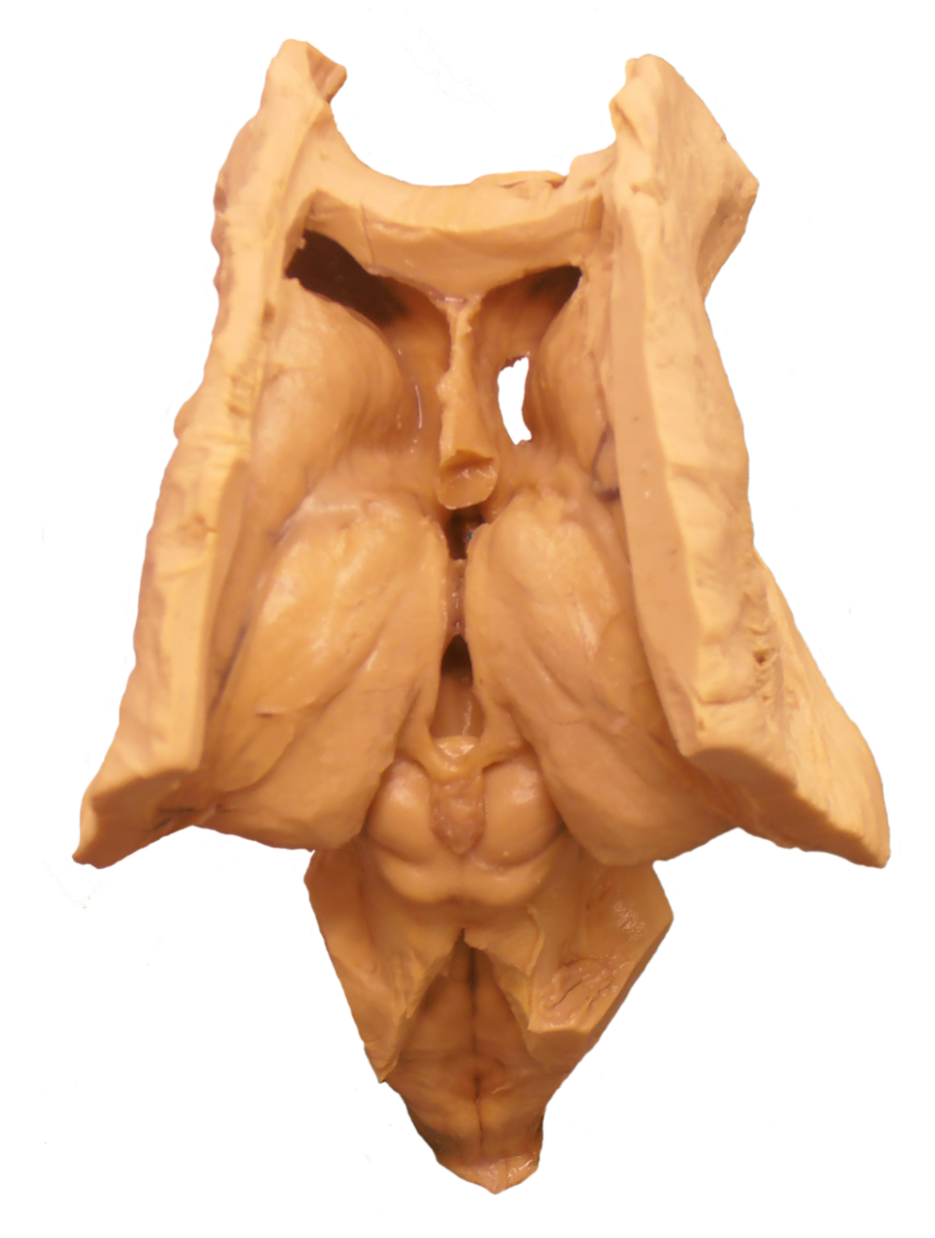
Indicated structure communicates with the interpeduncular nucleus via the:
Mammillothalamic tract
Stria medullaris
Habenulainterpeduncular fasciculus
Fornix
Ventral Amygdaloid Pathway
Notes:
C
Lab manual: Pg 68 within step 2

Slide 31
The indicated structure is a:
Relay nucleus that communicates with the primary motor cortex
Association cortex communicating with the pre-frontal cortex
Relay nucleus communicating with the primary limbic cortex
Association cortex communicating with the primary limbic cortex
Relay nucleus communicating with the primary somatosensory cortex
Notes:
C
This is the anterior nucleus of the thalamus
Pg 69 of lab manual

Slide 32
Indicated structure is important for communication between:
Hippocampus and pineal gland
Hypothalamus and the brainstem
Pineal gland and amygdala
Superior colliculus and prefrontal cortex
Posterior parietal lobule and thalamus
Notes:
B - Stria medullaris
Pg 67 course pack, last paragraph

Slide 33
Primary output of this structure is to:
Contralateral cerebellum
Ipsilateral Motor cortex
Ipsilateral substantia nigra
Ipsilateral inferior olivary nucleus
Contralateral pulvinar
Notes:
D:
Red nucleus

Slide 34
Indicated structures primary destination:
Entorhinal cortex
Primary limbic cortex
Hippocampus
Piriform cortex
BA 8
Notes:
D
This is the lateral olfactory stria

Slide 35
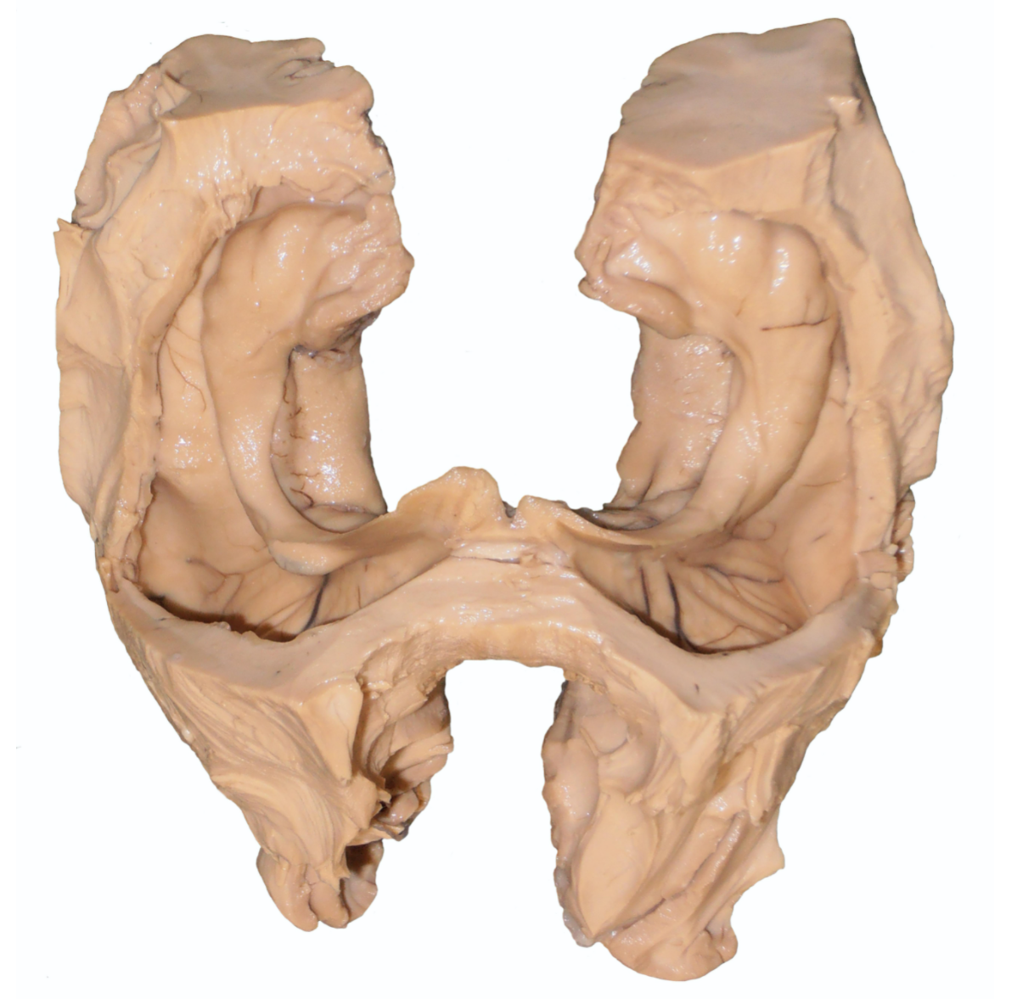
This region of the cortex contains how many layers?
3
5
7
6
10
Notes:
D
This is the subiculum, this is a 6 layered cortical structure that will be communicating with the hippocampus and the dentate gyrus (3 layer structure)
Pg 76 course pack top of page

Slide 36
Indicated structure communicates with the:
Diencephalon
Foramen of monro
Mammillary bodies
Laterodorsal nucleus
Ventrolateral preoptic nucleus
Notes:
C:
This is the column of the fornix
Carrying information about memory, facts, hippocampal info

Slide 37
What Fibers run through this part of the internal capsule
Frontopontine fibers and communicating fibers between thalamus and cingulate gyrus
Corticospinal fibers and communicating fibers between the VA/VL and motor cortices
Frontopontine fibers and communications between VA/VL and motor cortices
Parietal corticopontine fibers
Thalamomamillary fibers
Notes:
Structure: Anterior limb of the IC
A
Pg 6: Thalamus handout

Slide 38
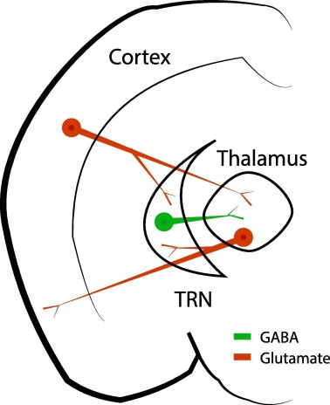
The indicated grey matter structure has what action on the thalamus
Excitatory only
Inhibitory only
Excitatory and inhibitory
Neither excitatory nor inhibitory
Notes:
B
Reticular nucleus
Reference under the image

Slide 39
Damage to this structure will likely cause:
Difficulty encoding memory and attention deficits
Retrograde amnesia
Anterograde amnesia
Chorea
Addictive tendencies
Notes:
A
Anterior thalamic nucleus
Pg. 3 thalamus handout (Anterior thalamic division)

Slide 40
Indicated structure receives what info:
Contralateral facial sensation
Ipsilateral body sensation
Ipsilateral facial sensation
Contralateral motor output
Contralateral body sensation
Notes:
E
This is the VPL
Notice that it is LATERAL to the VPM (Medial and inferior

Slide 41
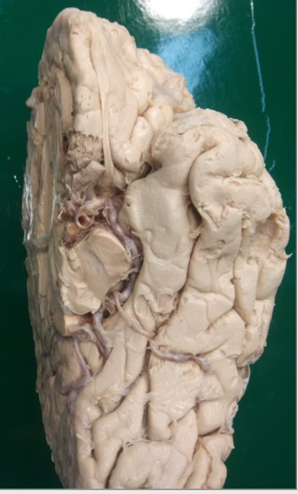
Primary afferents to this region contain:
Bilateral gustatory information
Contralateral auditory information
Ipsilateral olfactory information
Emotional response to environment
Bilateral olfactory information
Notes:
C
This is the piriform cortex , the lateral olfactory stria is sending olfactory info to this cortex (you can see the lat. olfactory stria making its way to the cortex)

